Slide 1
09 조인

Slide 2
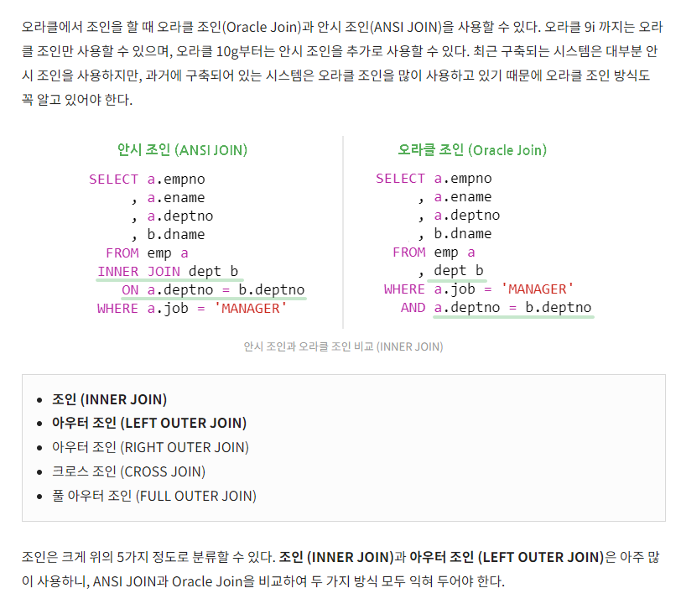
chaper 09
01
JOIN

Slide 3
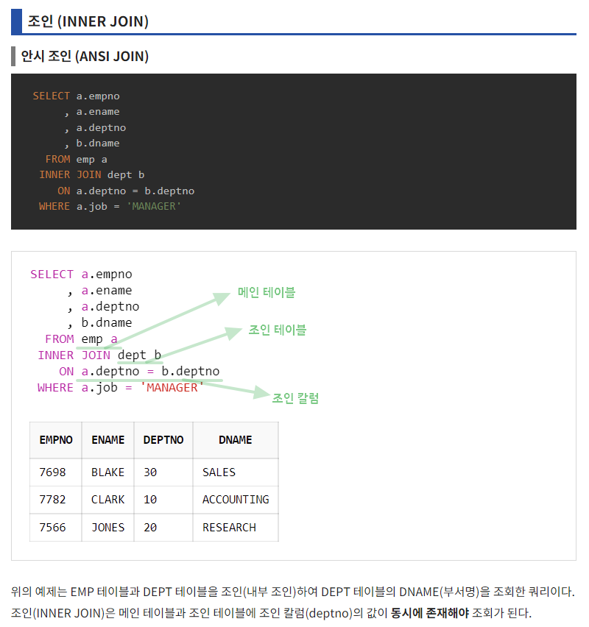
chaper 09
01
JOIN

Slide 4
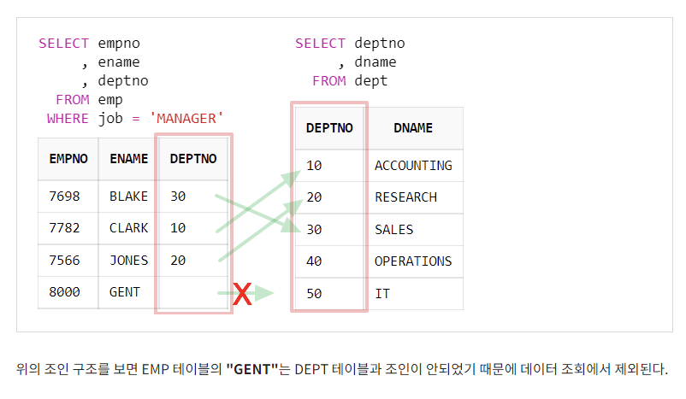
chaper 09
01
JOIN

Slide 5
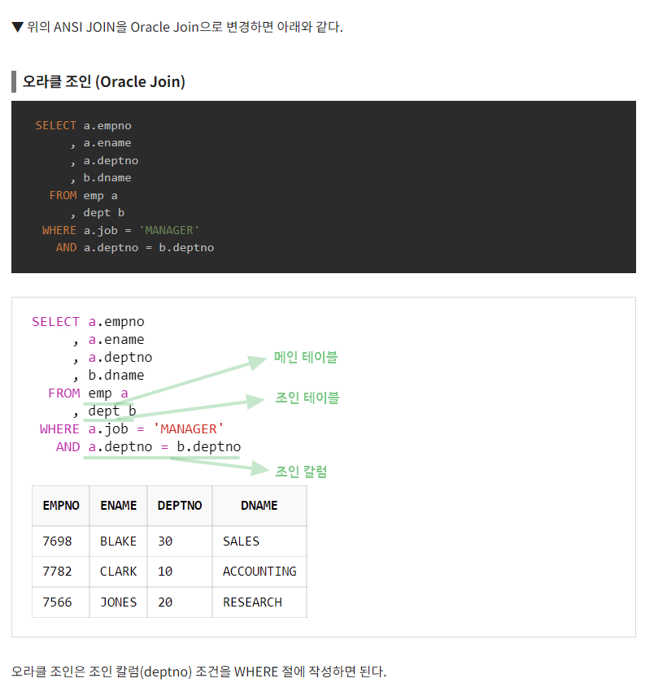
chaper 09
01
JOIN

Slide 6
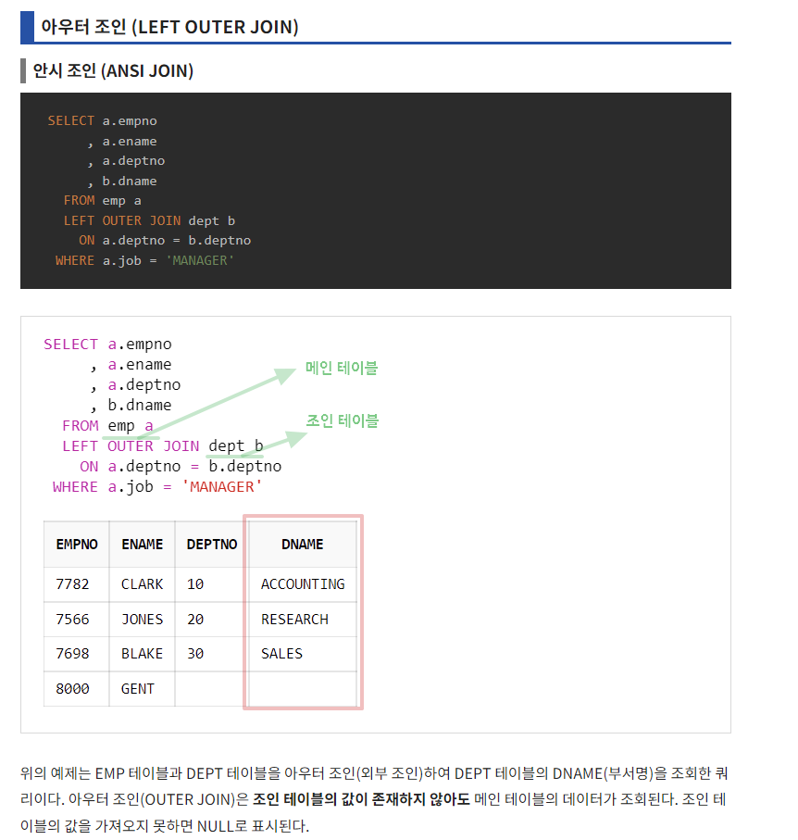
chaper 09
01
JOIN

Slide 7
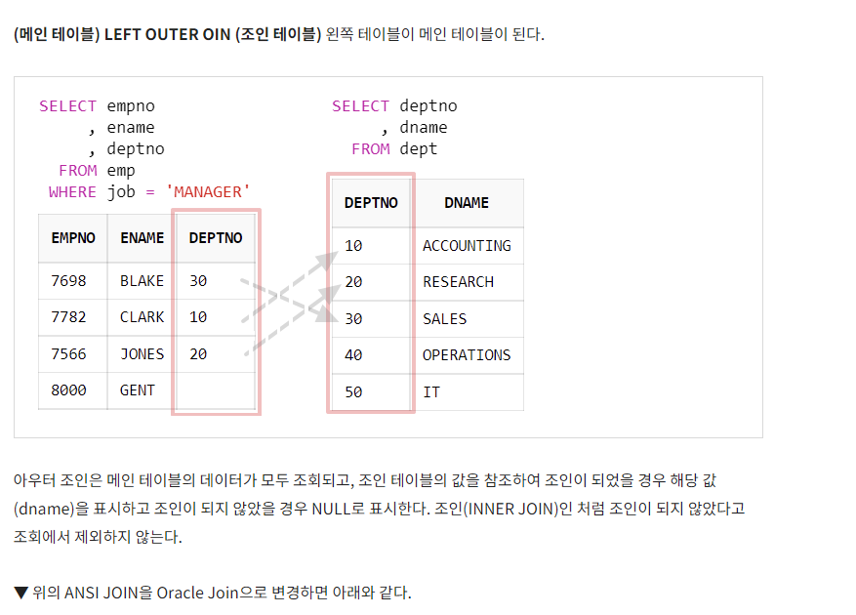
chaper 09
01
JOIN

Slide 8
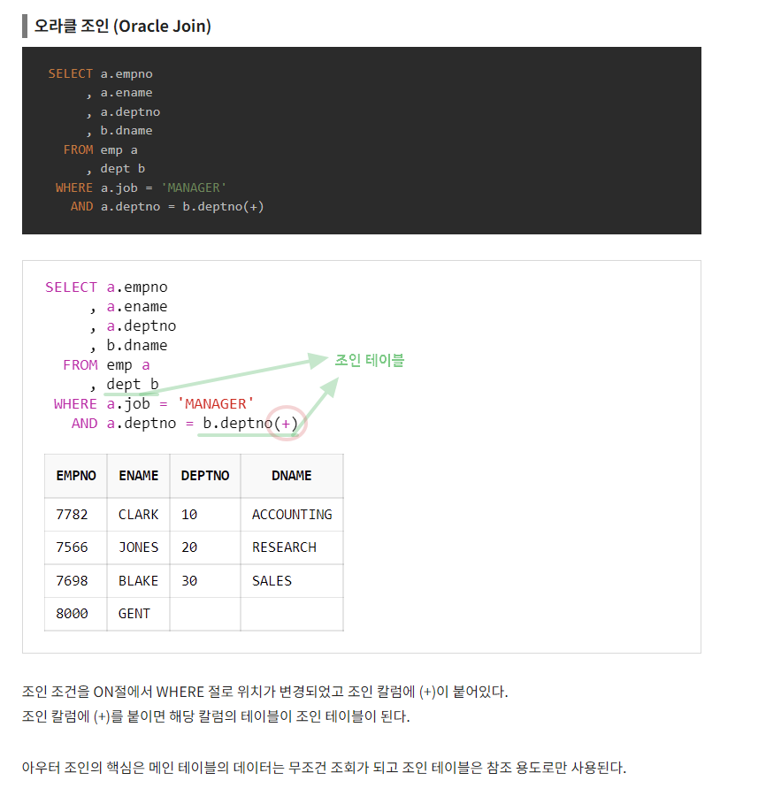
chaper 09
01
JOIN

Slide 9
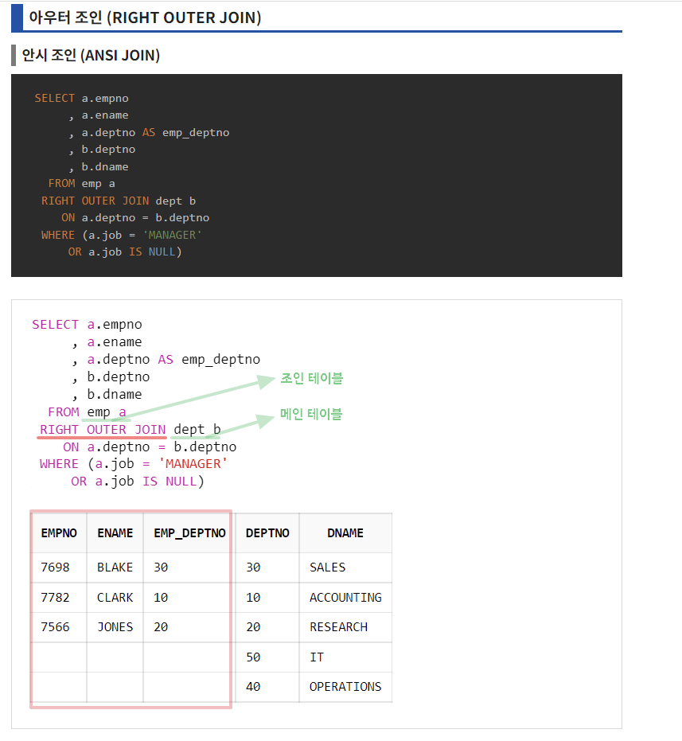
chaper 09
01
JOIN

Slide 10
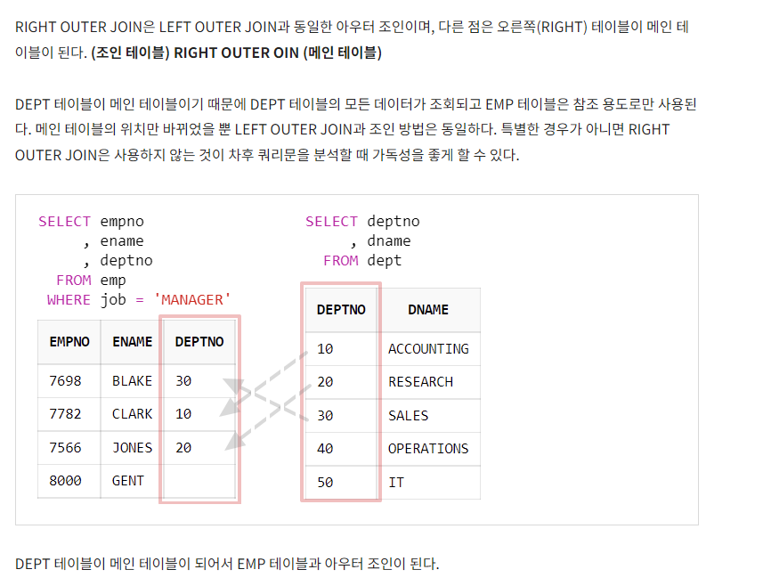
chaper 09
01
JOIN

Slide 11
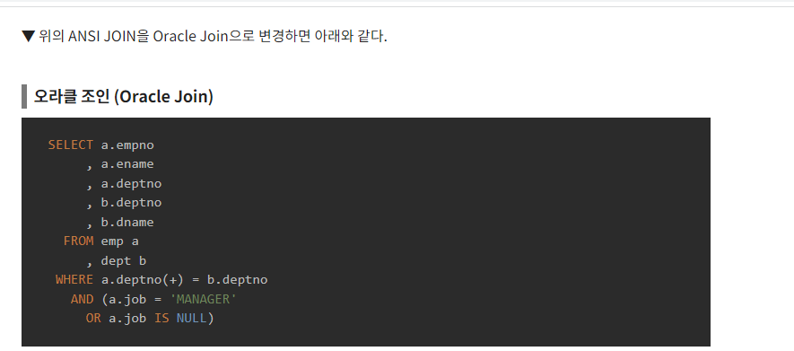
chaper 09
01
JOIN

Slide 12
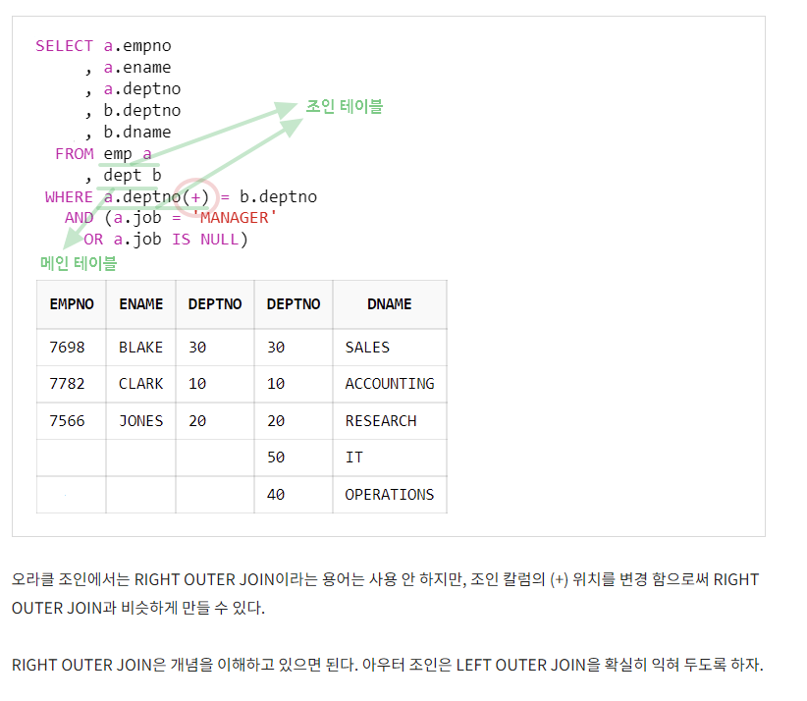
chaper 09
01
JOIN

Slide 13
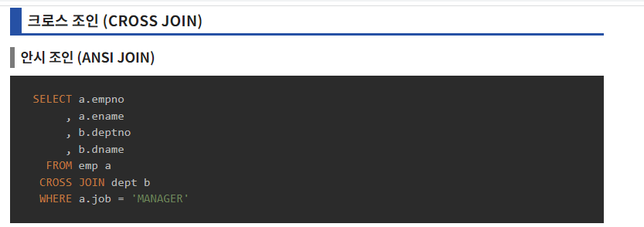
chaper 09
01
JOIN

Slide 14
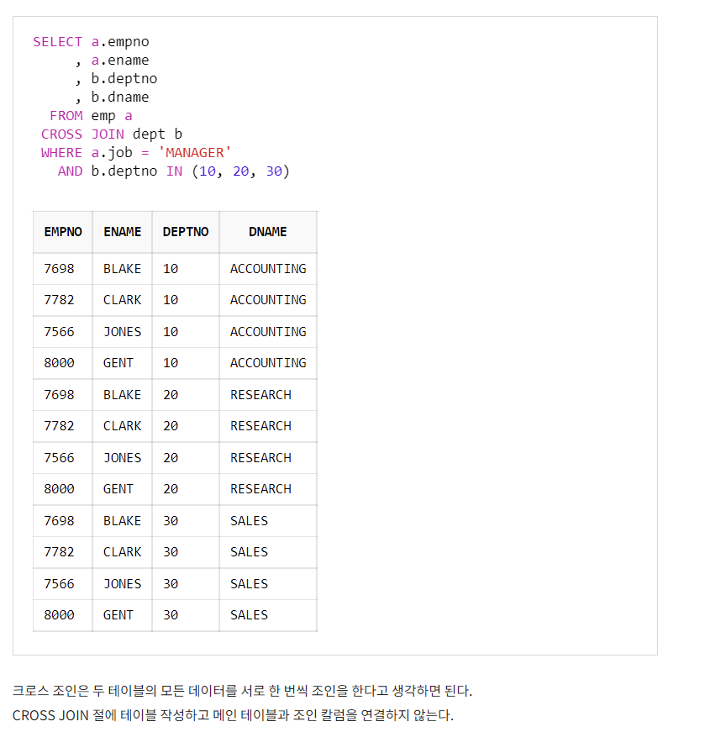
chaper 09
01
JOIN

Slide 15
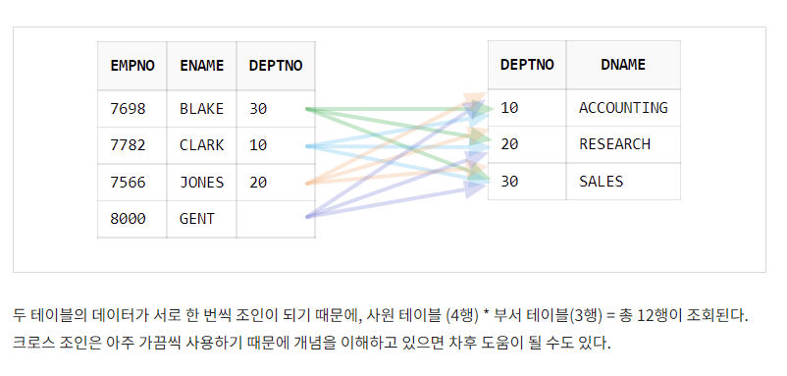
chaper 09
01
JOIN

Slide 16

chaper 09
01
JOIN

Slide 17
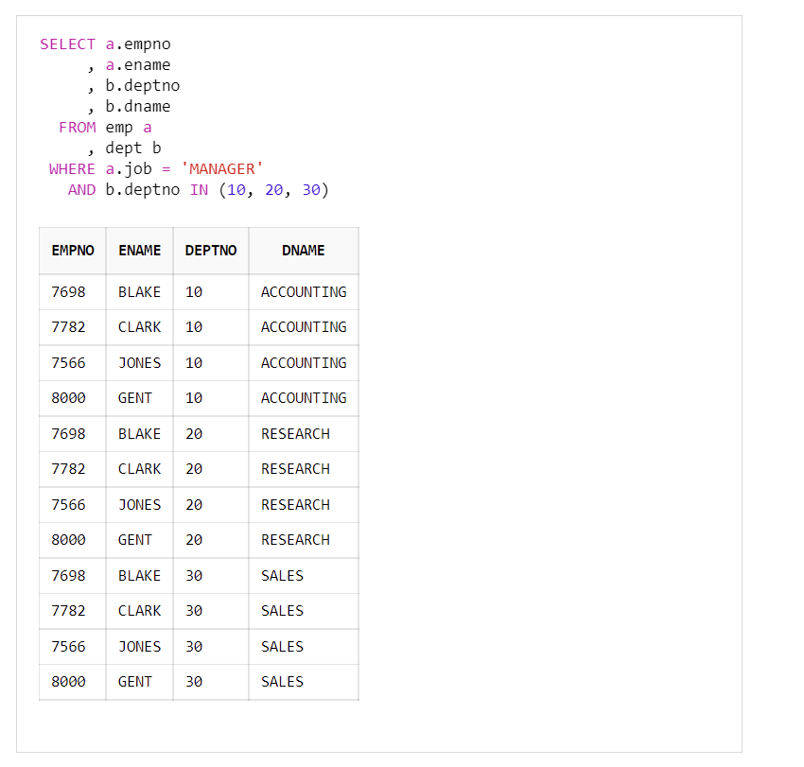

chaper 09
01
JOIN

Slide 18
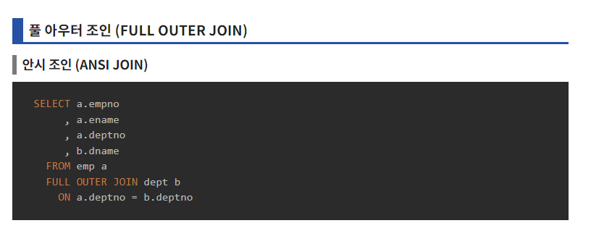
chaper 09
01
JOIN

Slide 19
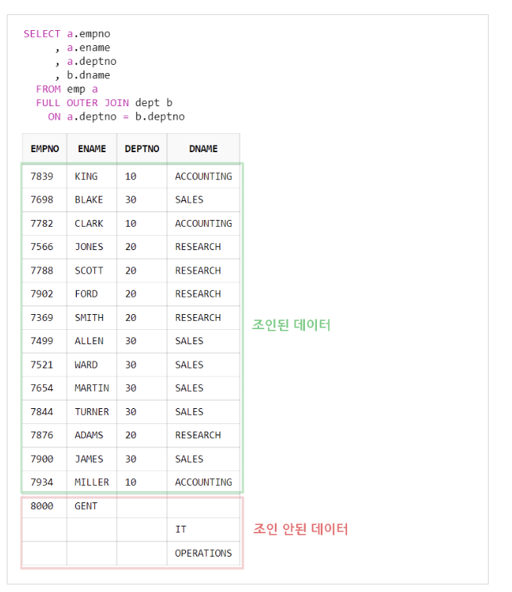
chaper 09
01
JOIN

Slide 20
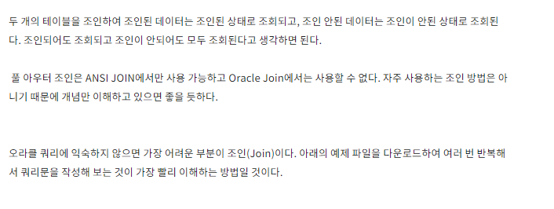
chaper 09
01
JOIN

Slide 21
E N D.
고생하셨습니다.

